Slide 1


Movie Recommendation System
Team Members:
Ajithkumar Sukumar
Pavan VV Ajith V Datla
Yashwanth Solipuram

Slide 2
Overview
Update
Introduction
Problem Statement
Challenges Faced by OTT Platforms
Requirements Gathering and Analysis
Class Diagram
BPMN Diagram
Database Management
ER Diagram
Cloud Implemenation
Why AWS?
Big Data Recommendations
Micro Services Architecture
UI/UX Design

Slide 3

Update
Task
Update
Next steps
BPMN
Finished
No further steps required
UML
Finished
No further steps required
Sql Storage
Finished
No further steps required
Cloud Implementation
Finished
No further steps required
Why AWS
Finished
No further steps required
BigData Recommendations
Finished
No further steps required
MicroServices Architecture
Finished
No further steps required
UI/UX Design
Finished
No further steps required

Slide 4
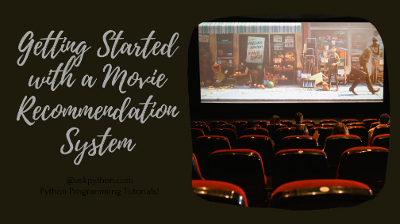
Introduction of the Movie Recommendation System
1
What is a movie recommendation system?
2
Why are they important?
It is widely used by OTT platforms to enhance the user experience. By leveraging machine learning algorithms, these systems analyze user data to generate accurate and relevant recommendations.
The movie recommendation system provides personalized movie suggestions based on user preferences, viewing history, and other factors.
3
How do they work?
4
What is the impact of movie recommendation systems?
There are various types of recommendation algorithms employed, and evaluation metrics are used to measure their effectiveness. Improving recommendation accuracy is a constant challenge, and strategies are implemented to enhance the performance of these systems.
Overall, movie recommendation systems play a crucial role in helping users discover new content and improving their streaming experience.

Slide 5

Problem Statement
OTT platforms like Netflix, Amazon Prime, and Disney+ face the challenge of efficiently recommending relevant movies to users based on their preferences while maximizing user engagement and retention. The goal is to enhance the user experience and increase user satisfaction by providing personalized movie recommendations.

Slide 6

Challenges Faced by OTT Platforms
1
Data Overload
2
Diverse Preferences
3
Content Diversity
Managing vast amounts of user data for accurate recommendations.
Understanding and catering to users with varied interests and tastes.
Providing relevant suggestions across different genres and languages.

Slide 7



Strategies for Improving Recommendation Accuracy
Enhance User Profiling
Iterative Feedback
Content Diversity
Further customization based on detailed user behavior and preferences.
Encourage user ratings and feedback to refine the recommendation system.
Ensuring recommendations cover a wide variety of genres and content types.

Slide 8

Requirements Gathering and Analysis:
Techniques Used: Requirements gathering involved stakeholder interviews, user surveys, and analysis of existing recommendation systems.
Stakeholder Analysis: Key stakeholders include users (viewers), streaming platform administrators, content providers, and system developers. Users are the primary beneficiaries, while administrators ensure system reliability and content providers aim to reach target audiences effectively.
Functional and Non-Functional Requirements:
•Functional requirements include user authentication, movie search and browsing, rating and reviewing movies, generating personalized recommendations, and providing feedback mechanisms.
•Non-functional requirements encompass system performance, scalability, security, and usability aspects.

Slide 9
Techniques Used:
•Stakeholder Interviews: Conducted interviews with users, streaming platform administrators, content providers, and system developers to gather insights into their expectations and requirements.
•Surveys: Distributed surveys to a sample of users to collect feedback on their movie watching habits, preferences, and satisfaction with existing recommendation systems.
•Document Analysis: Review existing documentation related to movie recommendation systems, industry best practices, and user feedback reports to identify common requirements and potential improvements.

Slide 10
Stakeholder Analysis:
•Users (Viewers): Primary stakeholders who use the movie recommendation system to discover and watch movies. They provide feedback through ratings, reviews, and interaction with recommended content.
•Streaming Platform Administrators: Manage and maintain the movie recommendation system infrastructure, monitor system performance, and ensure compliance with platform policies.
•Content Providers: Supply movies and other content to the streaming platform. They may seek insights into user preferences to optimize content offerings and improve audience engagement.
•System Developers: Design, develop, and maintain the movie recommendation system. They are responsible for implementing user requirements, optimizing algorithms, and ensuring system reliability and scalability.

Slide 11
Functional Requirements:
User Registration and Profile Management: Users can create accounts, update their profiles, and customize preferences such as genre preferences, language preferences, and viewing history.
Movie Search and Browsing: Users can search for movies based on various criteria such as genre, release year, cast, and director. They can also browse curated lists and recommendations.
Rating and Reviewing Movies: Users can rate movies they have watched and provide written reviews to share their opinions and experiences with others.
Personalized Recommendation Generation: The system analyzes user behavior, preferences, and viewing history to generate personalized movie recommendations. Recommendations are tailored to individual users' tastes and preferences.
Feedback Mechanism: Users can provide feedback on recommended movies, helping to improve the accuracy and relevance of future recommendations.

Slide 12
Non-Functional Requirements:
Performance: The system should respond quickly to user requests and generate recommendations in real-time.
Scalability: The system should be able to handle a large number of users and scale resources dynamically to accommodate increased demand.
Security: User data, including personal information and viewing history, should be securely stored and protected from unauthorized access or manipulation.
Usability: The user interface should be intuitive and user-friendly, making it easy for users to navigate, search for movies, and interact with recommendations.
Reliability: The system should be highly available and reliable, minimizing downtime and ensuring continuous service availability for users.

Slide 13
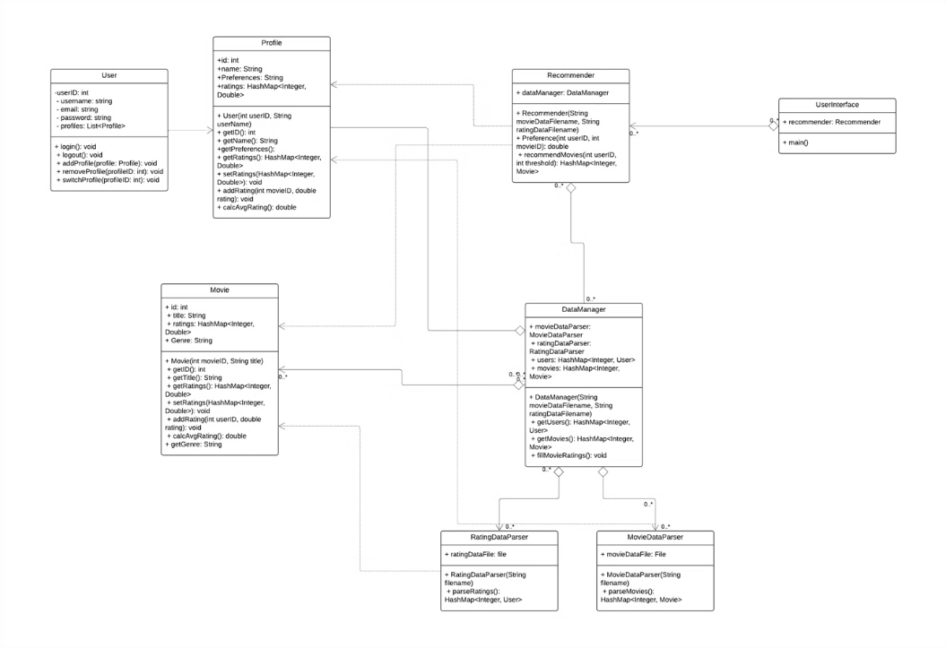
UML Class Diagram

Slide 14
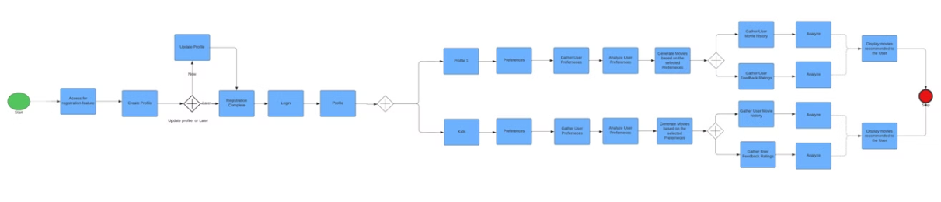
BPMN Diagram

Slide 15
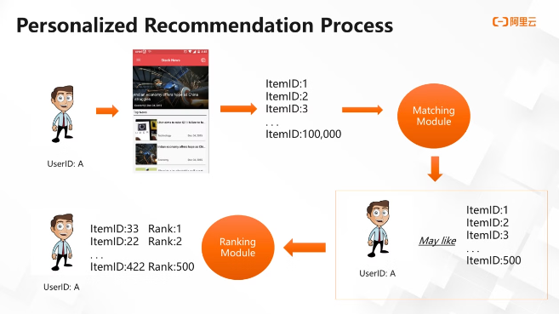
Database Management
The design for this program follows a three-tier architecture modewith a presentation tier, application tier, and data tier.
The presentation tier consists of the UserInterface class; the application tier consists of the Recommender class; and the data tier consists of the DataManager class, MovieDataParser class, and RatingDataParser class, with the first handling data storage and the latter two handling data parsing.
By adopting this highly modular model of software design, we expect all parts of the program to be easily modifiable with minimal impact on other parts. Also, the modularity of the program would make it easier for unit testing and human comprehension.

Slide 16
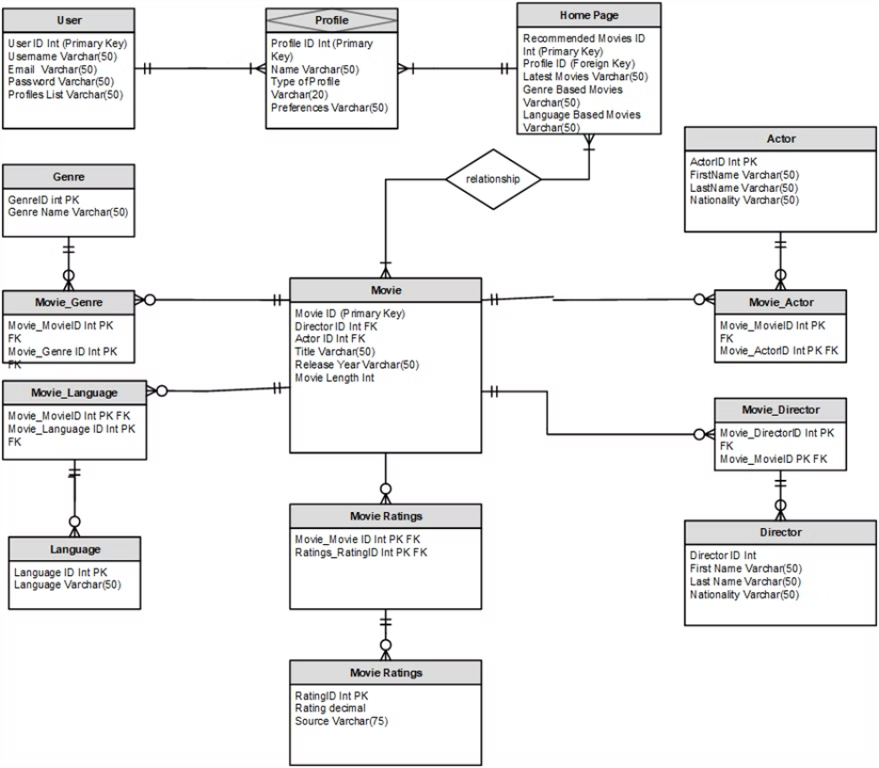
ER Diagram

Slide 17
Why Aws?
While AWS is often considered one of the best cloud platforms for various applications, including recommendation systems, it's essential to acknowledge that other cloud providers such as Google Cloud Platform (GCP), Microsoft Azure, and others also offer competitive services. Each platform has its strengths, and the choice depends on various factors specific to your project requirements. However, here are some reasons why AWS may be preferred over other platforms for building a movie recommendation system:
Amazon Personalize: AWS provides Amazon Personalize, a fully managed service tailored specifically for building recommendation systems. This service simplifies the process of training, deploying, and maintaining personalized recommendation models, offering a significant advantage for developers.
Extensive Service Portfolio: AWS boasts a vast array of services, including EC2 for compute, S3 for storage, DynamoDB for databases, and SageMaker for machine learning. The comprehensive service portfolio offers developers the flexibility to choose the right tools for their specific requirements and integrate them seamlessly.
Scalability and Flexibility: AWS's infrastructure is designed to be highly scalable and flexible, allowing businesses to scale resources up or down based on demand. This scalability is crucial for recommendation systems that often experience varying loads depending on user activity and traffic patterns.
Mature Ecosystem and Community: AWS has a mature ecosystem with a large and active community of users, extensive documentation, and robust support resources. This ecosystem provides developers with access to a wealth of knowledge, best practices, and support, facilitating the development and management of recommendation systems.
Global Reach and Reliability: AWS has a global infrastructure with data centers located in various regions worldwide. This global reach ensures low latency and high availability, essential factors for delivering a seamless user experience for a movie recommendation system accessed by users from different geographical locations.
Cost-Effectiveness: While AWS pricing can be complex, it offers various pricing models and cost management tools to optimize spending and control expenses. With careful planning and resource allocation, businesses can effectively manage costs and maximize the value obtained

Slide 18
Cloud Implementation
Compute Resources: AWS EC2 offers a balanced combination of CPU and memory resources for efficient handling of computational tasks and caching, ideal for diverse workloads.
Database: Amazon RDS provides a flexible and scalable relational database solution, ensuring efficient storage and retrieval of movie metadata and user preferences.
Networking: AWS Cloud offers high-speed networking capabilities, crucial for real-time applications, ensuring low latency and fast data transfer between application components.
Scalability and Load Balancing: AWS EC2 instances can automatically scale based on demand using Auto Scaling groups, coupled with Elastic Load Balancing (ELB) to evenly distribute incoming traffic, preventing bottlenecks.

Slide 19
Big Data Enhancement for Movie Recommendation System
The movie recommendation system can be enhanced by incorporating big data technologies. By leveraging the power of big data, the system can improve its recommendation accuracy and provide a more personalized and engaging user experience.
Here are some ways in which big data can impact the system design:
Scalability: Big data technologies allow the system to handle large volumes of data and scale seamlessly as the user base grows.
Real-time Processing: With big data frameworks like Apache Kafka and Apache Spark, the system can process streaming data in real-time, enabling instant recommendations based on user behavior.
Advanced Analytics: Big data platforms provide powerful analytics tools that can analyze user preferences, social media data, and other relevant information to generate more accurate and personalized recommendations.
Data Integration: Big data technologies facilitate the integration of various data sources, including user profiles, movie metadata, and user-generated content, to create a comprehensive view of user preferences.
Machine Learning: Big data frameworks enable the use of advanced machine learning algorithms to train recommendation models on massive datasets, leading to improved recommendation accuracy.

Slide 20
MicroService Architecture Diagram
User Profile Management Service:
This service is responsible for managing user data, including user profiles, preferences, and watch history.
It handles operations such as user registration, authentication, and profile updates.
The service interacts with the User Data Storage (database) to store and retrieve user-related information.
Movie Catalog Management Service:
Manages information about movies, including metadata such as title, description, genre, release year, etc., as well as availability.
Handles CRUD operations for managing the movie catalog, including adding new movies, updating existing entries, and deleting outdated ones.
Interacts with the Movie Data Storage (database) to store and retrieve movie-related data.
Recommendation Engine Service:
Analyzes user data and movie information to generate personalized recommendations for users.
Utilizes algorithms and machine learning techniques to recommend movies based on user preferences, viewing history, ratings, etc.
The service interacts with both User Data Storage and Movie Data Storage to access relevant data for generating recommendations. It stores recommendation data in its own Recommendation Data Storage (database).
Reviews and Ratings Service:
Allows users to provide feedback on movies by submitting reviews and ratings.
Manages user-generated content related to movie reviews and ratings, including storing, retrieving, and updating this information.
Interacts with the Reviews and Ratings Storage (database) to store and retrieve review and rating data associated with movies.
Notification Service:
Sends notifications to users, such as alerts about recommended movies, updates on new releases, or reminders for unfinished movies.
Handles various communication channels, including email, SMS, push notifications, etc., based on user preferences.
Utilizes a Message Queue (e.g., RabbitMQ, Kafka) to manage and distribute notification messages efficiently.
Caching and Data Partitioning:
Caching mechanisms are implemented to store frequently accessed data such as user profiles, movie metadata, and recommendation results.
Techniques like data partitioning are used to divide large datasets into smaller partitions or shards and distribute them across multiple storage instances.
Caching reduces the load on backend services by serving frequently accessed data quickly, improving response times and scalability.
Data partitioning enables horizontal scaling of data storage by distributing the data across multiple storage instances, improving data access performance and scalability.

Slide 21
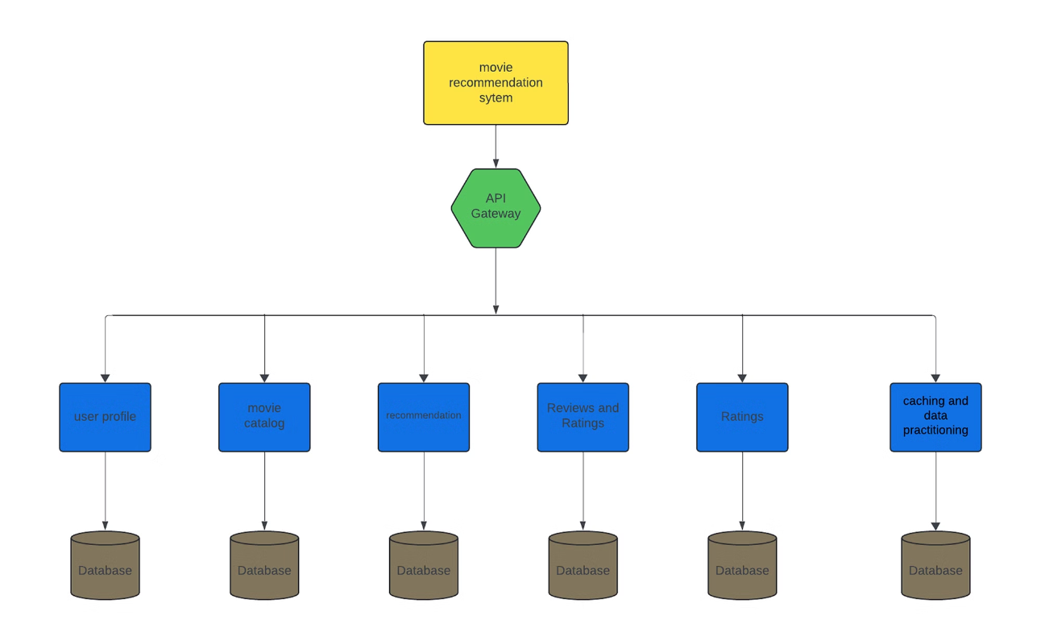

Slide 22
UI/UX Design
Designing a UI/UX for a movie recommendations system involves creating an interface that effectively presents movie suggestions based on user preferences. Here are some key considerations that we can think of:
User Profile Setup: User begin with a onboarding process where users can input their movie preferences, genres they like, actors they enjoy, and movies they've previously watched and rated.
Homepage: The homepage will greet users and provide options for them to explore movies based on different criteria such as popular movies, new releases, personalized recommendations, and trending genres.
Search Functionality: We are going to provide a robust search feature allowing users to search for movies by title, genre, actor, director, or keyword.
Personalized Recommendations: We are providing a section that displays personalized movie recommendations based on the user's profile and viewing history. Also, we will use algorithms to suggest movies similar to ones the user has previously enjoyed.
Filtering and Sorting Options: we are going to Offer users the ability to filter and sort movie results based on criteria such as genre, release date, rating, and popularity.
Movie Details popup: When user clicks on any movie we provide comprehensive information about each movie including a synopsis, cast and crew details, trailers, ratings, and reviews.
Watchlist page: A page is provided for users to save movies they're interested in to a watch list for easy access later.
User Interactions: We are also going to incorporate features for users to rate movies, write reviews, and share recommendations with friends via social media or messaging.
Responsive Design: We are providing a UI that seamlessly works across different devices including desktops, tablets, and smartphones.
Accessibility: To make accessibility easier we provide features such as text-to-speech capabilities, high contrast options, and keyboard navigation.
AIbot: To make searching easier for we are providing AIbot where users can describe their feelings through text or speech and AIbot gives recommendations based on the input given by user.
To improve or provide any extra feature to make the application more interactive:
Feedback Mechanism: we are planning to provide feedback page for users to provide feedback on the recommendations they receive allowing the system to continuously learn and refine its recommendations, and also provide suggestion box for users to provide their experience with the application which will help to improve the application over time.

Slide 23

Thank You!!

